Slide 1
BITS ZG553: Real Time Systems L9 – Hardware for Real Time Systems
K G Krishna
WILP Division, BITS-Pilani, Hyderabad

Slide 2

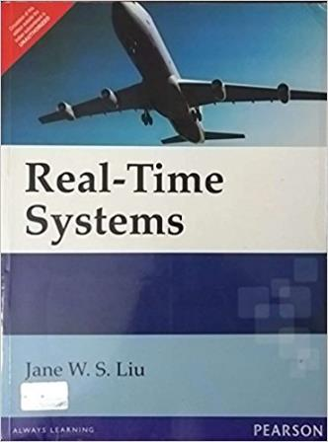
Text Book / References
Reference (R1)
Text Book (T1)
Note: As the above two books focus on theoretical treatment of the subject, Students are strongly advised to refer to web sources / MOOCs videos / library within their own organizations for more practical understanding of the topics.

Slide 3
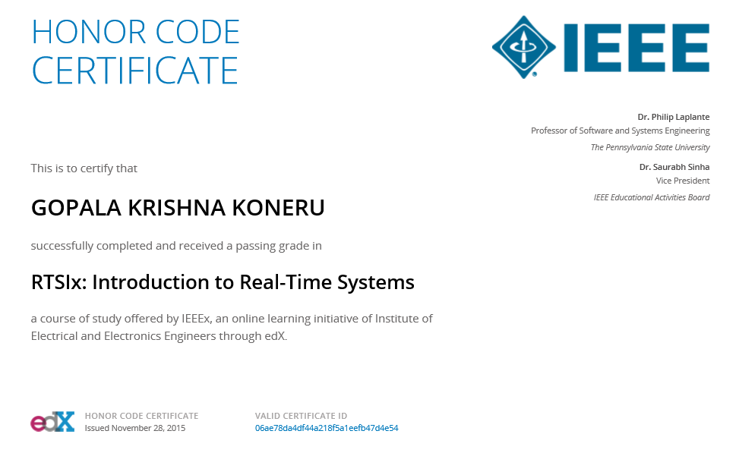
Excellent MOOCs Videos
(Coursera, edX,…)

Slide 4
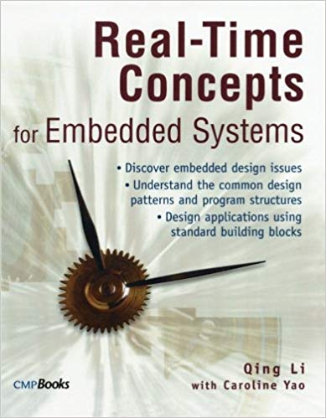
RTS Primer – For Light Reading

Slide 5
L-9: Hardware for Real Time Systems
[Processor Architecture, Memory, Peripheral Interfacing]
[Ref: Notes/PPT]
Note: Students are requested to NOT to rely on PPTs/Recorded sessions as their only source of knowledge, explore sources within your own organization or web for any specific topic; attend classes regularly and involve in discussions;
PLEASE DO NOT PRINT PPTs, Save the Environment!
Source PPT Courtesy: Some of the contents of this PPT is sourced from Presentatoons of Prof K R Anupa / Prof B Mishra, BITS-Pilani WILP Division

Slide 6
Motivation
Many real-time systems are embedded systems
Embedded systems interact closely with specialize input and output devices including sensors and actuators
Hardware structure can affect timing and require special software design techniques
Real-time systems engineers must have some familiarity with hardware and do some “low level” programming

Slide 7
Processor Architectures
Von Neumann Architecture
Harvard Architecture

Slide 8
Von Neumann Architecture
Described in 1945 by the mathematician and physicist John von Neumann and others in the First Draft of a Report on the EDVAC.
Also known as Princeton Architecture.
CPU is connected to Memory and I/O through the System Bus.
In a Von Neumann Architecture, I/O is Memory Mapped.
CPU
System Bus
Memory
System Bus constitutes:
Unidirectional Address Bus
Bidirectional Data Bus
Control Bus, which is a heterogeneous collection of independent lines such as control, status and power lines.
I/O

Slide 9
Harvard Architecture
The name Harvard Architecture comes from the Harvard Mark I relay-based computer.
Separate data and address bus
It is possible to access program memory and data memory simultaneously.
Typically, code (or program) memory is read-only and data memory is read-write. Therefore, it is impossible for program contents to be modified by the program itself.
But the price paid is increase in chip area (therefore power consumption)
Many modern CPUs comprises both Harvard and von Neumann characteristics: the separate on-chip instruction and data caches have a Harvard type interface, while the common off-chip cache memory is interfaced through a single system bus.

Slide 10
CPU Internal Architecture
Control Unit
Interfaces to the system bus through Program Counter Register (PCR)
PC points to the address from which the next instruction to be fetched.
Instruction fetched is stored in the Instruction Register (IR)
Instruction is then decoded, desired operands are fetched from memory and appropriate command is given to the ALU of the Data Path
Data Path
ALU (Arithmetic and Logic Unit), performs the desired operation.
The output of ALU is either stored in Registers of Memory depending upon the Instructions
Also various status flags such as Carry/Borrorw, Zero etc are updated in the status registers depending upon the state of the CPU. These flags are used for implementing conditional instructions.
Instruction processing takes place inside the CPU
It has 3 parts: Control Unit, Internal Bus and Data Path
CPU
Control Unit
PCR
Instruction
Access
Address
Bus
IR
Internal
Bus
Data path
ALU
Data
Bus
Data
Access
Registers

Slide 11
Instruction Processing
Instruction processing requires multiple consecutive stages.
Typical instruction processing stages constitute: Fetch, Decode and Execute.
But these stages can be further divided into multiple sub-stages. For example, we can have 5 stages for instruction processing: Fetch, Decode, Load, Execute and Store.
The duration of each instruction may vary, because each of these stages may take different amount of clock cycles.
Fetch
Fetch
Decode
Decode
Load
Execute
Execute
Store
Clock Cycles
Clock Cycles

Slide 12
Instruction Processing
Each Instruction consists of an Opcode and zero, one or more Operands.
Example: MOV AX, BX
Here, MOV is the Opcode and AX and BX are the Operands
Addressing modes are the way CPU accesses the Operands
Immediate: ADD AX, 5 ; AX = AX + 5
Register Direct: SUB AX, BX ; AX = AX - BX
Register Indirect: ADD AX, [BX]; AX = AX + *BX
… … … … …
Two principal techniques for implementing the control unit
Microprogramming
Every instruction consists of a sequence of primitive hardware commands, microinstructions for activating he data path.
Suitable when the number of instructions is large
Instruction processing is slower
Hardwired Logic
Each instruction is mapped to some combinational and sequential logic hardware.
Suitable when the number of instructions is small
Results in fast instruction processing
In order to conserve power, modern processors implements ‘slowdown modes’.
Specific instructions enable such modes, where the voltage and/or frequency are lowered, reducing the power consumption.

Slide 13
Pipeline
Example of a 3-stage pipeline:
Fetch, Decode, Execute
3 cycle latency
instruction
i
Fetch
Decode
Execute
i+1
Fetch
Decode
Execute
i+2
Fetch
Decode
Execute
cycle
t
t+1
t+2
t+3
13
t+4

Slide 14
Pipeline Hazards
Structural Hazards
These occur when a single piece of hardware is used in more than one stage of the pipeline, so it's possible for two instructions to need it at the same time.
Example: One memory unit being shared by subsequent instructions)
Data Hazards
This is when reads and writes of data occur in a different order in the pipeline than in the program code.
RAW (Read After Write): Occurs when, one instruction reads a location after an earlier instruction writes new data to it, but in the pipeline the write occurs after the read.
WAR (Write After Read): A write occurs after a read, but the pipeline causes write to happen first.
WAW (Write After Write): Two writes occur out of order.
In order to resolve these hazards, pipeline stall happens.
Control Hazards
This is when a decision needs to be made, but the information needed to make the decision is not available yet.
Example: Branch instruction in a pipeline.
In some RISC architectures, the instruction following the branch is executed whether or not the branch is taken. It is called delayed branch.

Slide 15
Where do Processors Spend Time ?
Instruction Type | Dynamic Usage
Data movement | 43%
Control flow | 23%
Arithmetic operations | 15%
Comparisons | 13%
Logical operations | 5%
Others | 1%
Source: Steve Furber, ARM System-on-chip Architecture, Second Edition, Pearson, 2007

Slide 16
CISC Processor Architecture
CISC – Complex Instruction Set Computer
Instructions are of variable format and length
Large number of instructions
Practically any instruction can reference memory
Single set of work registers
Micro-programmed instruction decode logic. Complexity of instruction is handled at this level
Great variety of addressing modes
No instruction pipelines
Programmer’s coding effort is simplified
Example: x86 Architecture

Slide 17
RISC Processor Architecture
RISC – Reduced Instruction Set Computer
Fixed 32-bit instruction size
Load-store architecture – Instructions operating on data operates only on registers.
Large register bank of thirty-two 32-bit registers
Hard-wired instruction decode logic (CISC processors use large microcode ROMs)
Pipelined execution
Single-cycle execution (most of the instructions)
Performance is enhanced
Example: ARM Architecture

Slide 18
Multi-core Processor
Motivation
CPU architecture is evolving, with higher frequencies, longer pipelines.
As clock frequencies increases, power consumption increases.
Cooling such high speed processors is an costly affair.
Then why not have processors with multiple cores, operating in parallel ?
Multi-core processors
Have individual cores with private cache memory, separate instruction and data caches.
These small on-chip caches are interfaced to larger on-chip common cache memories
Core 1
Core 2
Core 3
Core 4
I & D Caches
I & D Caches
I & D Caches
I & D Caches
System Bus
Common I & D Caches

Slide 19
Multi-core Processor System
From HW Perspective:
Homogenous: If all CPU cores are of same architecture
Heterogeneous: If all CPU cores are of different architecture
From SW Perspective:
AMP: Asymmetric Multi-processing
SMP: Symmetric Multi-processing

Slide 20
Multi-core Processor System - AMP
CPU cores can be of homogenous or heterogeneous architectures
Each core has own address space
Used when different architectures are optimal for specific activities, such as: one is for DSP and other one is for MCU
There is an opportunity to deploy different O/Ses on different cores
Application 1
Application 2
Thread 1
Thread k
Thread 1
Thread m
Android
Middleware
Linux
Nucleus
AMP Multi-core processor
Core 1
Core n

Slide 21
Multi-core Processor System - SMP
CPU cores are of homogenous architecture
CPU cores share the memory space
A single O/S runs on all the cores
Some kind of communication facility between the CPUs is provided this is normally through shared memory, but accessed through the API of the OS
Typically, SMP is used when an embedded application simply needs more CPU power to manage its workload
Application
Thread 1
Thread k
Android 3.0 or later
SMP Linux
SMP Multi-core processor
Core 1
Core n

Slide 22
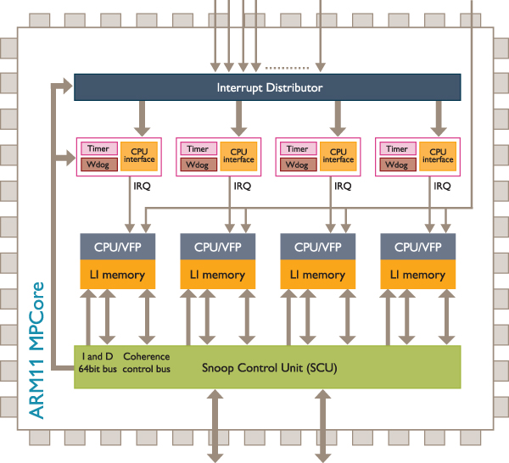
ARM11MPCore Architecture
SMP Architecture
Shared L1 cache is managed by Snoop Control Unit:
Each CPU’s snooping unit looks at writes from other processors
If a write modifies a location in this CPU’s level 1 cache, the snoop unit modifies the locally cached value
Interrupt Distributer
Masks and prioritizes the interrupts as in standard interrupt system
Identifies the set of CPUs that can handle the interrupts
Sends each CPU its highest priority pending interrupt
Source: http://www.arm.com/products/processors/classic/arm11/arm11-mpcore.php

Slide 23
Common DSP Processor features
Harvard architecture
Needed for accessing multiple memory locations simultaneously
Dedicated single-cycle Multiply-Accumulate (MAC) instruction (hardware MAC units)
Required for processing arithmetic operations like
Single-Instruction Multiple Data (SIMD)
Very Large Instruction Word (VLIW) architecture
Pipelining
Saturation arithmetic
Special Execution Units with
Minimum overhead looping
Low interrupt and branch latency
Fast context switching
Register banking / stacking
Cache
DMA
N
Y =
a_{n} x_{n}
*
n = 1

Slide 24
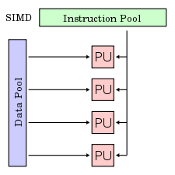
SIMD – Single Instruction Multiple Data
One instruction operates on multiple data simultaneously.
Example: Addition of two row vectors:
Same ADD operation on 4 separate data in parallel

Slide 25
VLIW Architecture
VLIW - Very Long Instruction Word
Exploits instruction level parallelism
Has multiple execution units executing in parallel
Hence has multiple register files to help parallel execution of instructions
Instruction word is a combination of multiple instructions, hence it is very long
Compiler reorders the instructions in order to achieve maximum parallel execution possible. Hence VLIW compiler is very complex.

Slide 26
VLIW Architecture
Internal Program Memory (Cache)
8x32
Inst fetch, decode & dispatch
L1 | S1 | M1 | D1
Register File A
L2 | S2 | M2 | D2
Register File B
Internal
Data RAM

Slide 27
VLIW Architecture
Instruction Fetch
EU1
EU2
EU3
Register File

Slide 28
Superscalar Architecture
Instruction Fetch
Dispatch unit
EU1
EU2
EU3
Register File

Slide 29
Difference between VLIW and Superscalar Architectures
VLIW
Single and very long instruction word containing multiple instructions
Compiler does instruction reordering (Static instruction scheduling)
Superscalar
Multiple instructions are issued separately
Hardware does instruction reordering (Dynamic instruction scheduling)

Slide 30
Any Questions on
Processor Architectures?

Slide 31
Memory Systems
Memory access has major contribution in latency.
It becomes important when the utilization factor is in dangerous zone (83% - 99%) (Refer to lecture 2)
In such systems hierarchical memory architecture may cause aperidic jobs to miss deadlines with considerable delays.
So it is necessary to understand memory technologies, so that appropriate design decision can be taken

Slide 32
Different Classes of Memory
Traditional Distinction between Memories:
ROM (Read Only Memory) – Non-volatile
RAM (Random Access Memory) – Volatile
ROMS used to get programmed once at the beginning using a special programming units.
But at present, EEPROM and Flash memories can be rewritten without any special programming units.
At present following types of Memories are widely used
Non Volatile
EEPROM
Flash
Volatile
SRAM
DRAM

Slide 33
Non-Volatile Memory
Erasing is slower than RAMs
Each device can be rewritten 1000,000 – 1,000,000 times only.
EEPROMs are usually used for storing nonvolatile programs and parameters.
Flash memory is usually used for storing both application programs (including operating system) and large data records.
These are slower to read compared to RAM
So it is a common practice in many real-time systems to load the application-program (including the operating system) from a flash memory to the RAM and then run it from the RAM.
In many cases the flash memory used is a movable one (e.g. a SD Card or a USB Memory stick)

Slide 34
SRAM and DRAM
SRAM-type memory cell requires typically 6 transistors, while DRAM cell requires a single transistor and a capacitor only.
So SRAM takes mores chip area compared to DRAM.
Hence SRAMs are costlier than DRAMs.
But SRAMs are faster than DRAMs.
DRAM has the issue of leakage in their storage capacitors. So DRAMs need to be refreshed periodically (typical refresh cycle is 3-4 ms).
While designing a RAM subsystem of a real-time system, the basic rule of thumb is that if you need a large amount of memory, then use DRAM, otherwise go for SRAM.

Slide 35
Evolution of DRAM
First page mode (FPM) DRAM
Extended data output (EDO) DRAM
Synchronous DRAM (SDRAM)
Direct Rambus DRAM (DRDRAM)
Double data rate 3 synchronous DRAM (DDR3 DRAM)

Slide 36
Memory Hierarchy
CPU Clock Rates are increasing at a faster rate compared to DRAM access times.
Programmers always desire faster and infinite memory.
Solution is Memory Hierarchy.
In order of fastest to slowest, memory should be assigned, considering cost as follows:
internal CPU memory
registers
cache
main memory
memory on board external devices

Slide 37
Cache
Cache memories rely on the ‘locality of reference’ principle.
Locality of reference
Refers to the address distance between memory between consecutive code and data access.
If the code or data fetched tends to reside close in memory, then the locality of reference is low.
Cache
Controller
CPU
L2 Cache
L1
Cache
A cache is a relatively small storage of fast memory where frequently used instructions and data are kept.
Basic operations of Cache
Suppose CPU requests the content of a DRAM.
First the cache controller checks the address to see if the particular location is in the cache.
If present, the data is immediately retrieved from the cache, which is significantly faster.
If the address is not in the cache, then a cache miss occurs. Subsequently the cache content gets written back to the main memory and the new block is loaded into the cache.
Cache Hierarchy
L1 Cache: Nearest cache to CPU
L2 Cache: Next level cache between L1 cache and Main Memory

Slide 38
Cache Access Time
t_{main} – access time for main memory
t_{L1} – access time for primary cache
h₁ – hit ratio of primary cache
t_{L2} – access time for secondary cache
h₂ – hit ratio of secondary cache but not primary
If system has only L1 cache
Average access time, t_{av} = h₁t_{L1} + (1-h₁)t_{main}
If system has L1 and L2 cache
Average access time, t_{av} = h₁t_{L1} + h₂t_{L2} + (1-h₁ -h₂)t_{main}

Slide 39
Cache Access Time - Example
Problem:
Assume that the system has a two-level cache. The level-1 cache has a hit rate of 90% and the level-2 cache has a hit rate of 97%. The level 1 cache access time is 4 ns, the level 2 cache access time is 15 ns and access time of main memory is 80 ns. What is the average memory access time?
Solution:
h₁ = 0.9,
h₂ = (1-0.9) X 0.97 = 0.1 X 0.97 = 0.097,
t_{L1} = 4 ns, t_{L2} = 15 ns, t_{main} = 80 ns.
t_{av} = h₁t_{L1} + h₂t_{L2} + (1-h₁-h₂)t_{main}
= 0.9 X 4 ns + 0.097 X 15 ns + (1 – 0.9 – 0.097) X 80 ns
= 0.9 X 4 ns + 0.097 X 15 ns + 0.003 X 80 ns
= 3.6 ns + 1.455 ns + 0.24 ns
= 5.295 ns

Slide 40
Any Questions on
Memory Systems?

Slide 41
Peripheral Interfacing:
Interrupts
An hardware interrupt is an external hardware signal that initiates an event.
Each interrupt is associated with an interrupt vector address, which contains the interrupt handler routine.
Interrupt handler routine is a program for the desired action to be taken when the interrupt occurs.
There are software interrupts as well, which are generated internally.
A typical interrupt service process is as follows
The interrupt request line is activated
The interrupt request is latched by the CPU hardware
The processing of ongoing instruction is completed
The content of program counter register (PCR) is pushed to the stack
The content of status register (SR) is pushed to the stack
The PCR is loaded with the interrupt handler’s address.
The interrupt handler is executed.
The original content of the SR is popped back from the stack.
The original content of the PCR is popped back from the stack.

Slide 42
Programmable Interrupt Controller (PIC)
When number of interrupt sources are more than the available external interrupt inputs on a microprocessor/microcontroller, then PIC chips are used.
Priorities can be assigned among the interrupts.
Example: 8059 for x86
Memory
Programmable Interrupt Controller
CPU
Vector 1
PCR
Vector 2
.
.
.
.
.
.
External
Interrupt
Line
External
Interrupts
Vector 3
Interrupt Handler
.
.
.
Interrupt Handler

Slide 43
Direct Memory Access (DMA)
Access to the computer’s memory is given to other devices in the system without CPU intervention.
Information is transferred directly into main memory by the external device.
DMA controller is required unless the DMA circuitry is integrated into the CPU.
Because CPU participation is not required, data transfer is fast.
DMA is the most preferred method for data transfer in real-time systems.

Slide 44
DMA Transfer Process
I/O Device requests DMA transfer by activating DMA-request signal (D_REQ)
This cause the DMA Controller issue a bus-request signal (B_REQ) to the CPU.
Then the CPU finishes its present bus cycle and activates a bus-acknowledgement signal (B_ACK).
After recognizing B_ACK signal, DMA Controller activates a DMA-acknowledgement signal (D_ACK) to the I/O device.
Then I/O device performs the data transfer to the memory.
One the transfer is done, the DMA controller deactivates the B_REQ signal, giving the bus back to the CPU.
CPU
DMA Controller
I/O Device
CPU controls
the system bus
Time
D_REQ
B_REQ
B_ACK
D_ACK
DMA Controller
controls the
system bus

Slide 45
Thank You.
Any Questions?

